Slide 1
Project Presentation of Back End Engineering Project (BEE) (22CS026)
On
Hostel Sync
Akashdeep Singla 2210991212
Akshit 2210991236
Ananya Gupta 2210991258
Akriti 2210991258
Supervised By
Mr. Reshab Kumar
Department of Computer Science and Engineering,
Chitkara University, Punjab

Slide 2
Abstract
Hostel Sync is a web-based application designed to streamline the administrative tasks and operations of hostels. This system offers a comprehensive solution for managing various aspects of hostel management, including student registration, accommodation allocation, fee management, attendance tracking, and maintenance requests.
The system aims to improve efficiency, transparency, and communication within the hostel environment. By automating routine tasks, reducing paperwork, and providing real-time access to information, it empowers hostel administrators to make informed decisions and enhance the overall hostel experience for both students and staff.
2

Slide 3
Keywords
Booking System
Realtime Analytics
Email Integration
QR Scanner for Record Management
3

Slide 4
Introduction
Problem Statement
Hostels often face challenges in managing their operations efficiently, such as:
Manual processes: Time-consuming and error-prone manual tasks, including student registration, accommodation allocation, fee collection, and attendance tracking.
Lack of transparency: Limited visibility into hostel operations, leading to difficulties in monitoring and managing resources effectively.
Inefficient communication: Challenges in communicating with students and staff, resulting in delays and misunderstandings.
Paperwork: Excessive paperwork, leading to storage issues and increased administrative costs.
These challenges can negatively impact the overall hostel experience for students and staff.
4

Slide 5
Software and Hardware Requirement Specification
3.1 Methods
The development methodology follows Agile principles, focusing on iterative development and continuous feedback. The project will be divided into sprints, each delivering key components of the system
3.2 Programming/Working Environment
Programming Language: JavaScript (React for frontend, Node.js for backend)
Database: MongoDB (NoSQL database)
Communication: WebSocket (for chat functionality)Email/SMS
Integration: Twilio (for SMS) and Node mailer (for email notifications)
3.3 Requirements to run the application
Operating System: Windows 10/Linux/MacOS
RAM: Minimum 8GB
Processor: Intel i5 or equivalent Software
Dependencies: Node.js, MongoDB , Express
Browser: Latest versions of Chrome, Firefox, or Safari

Slide 6

Landing Page of the website

Slide 7
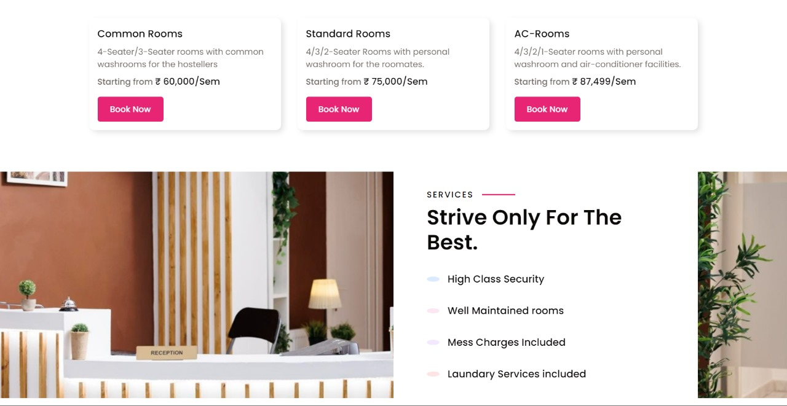

Slide 8
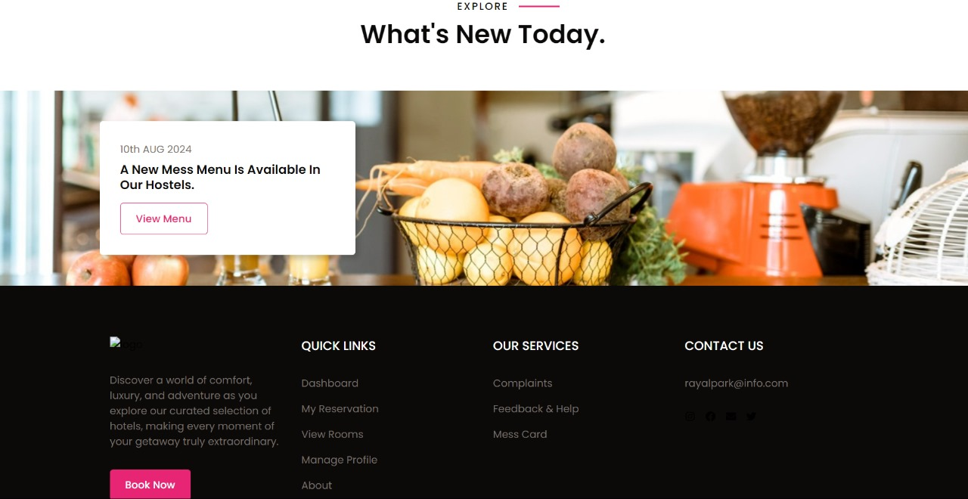

Slide 9
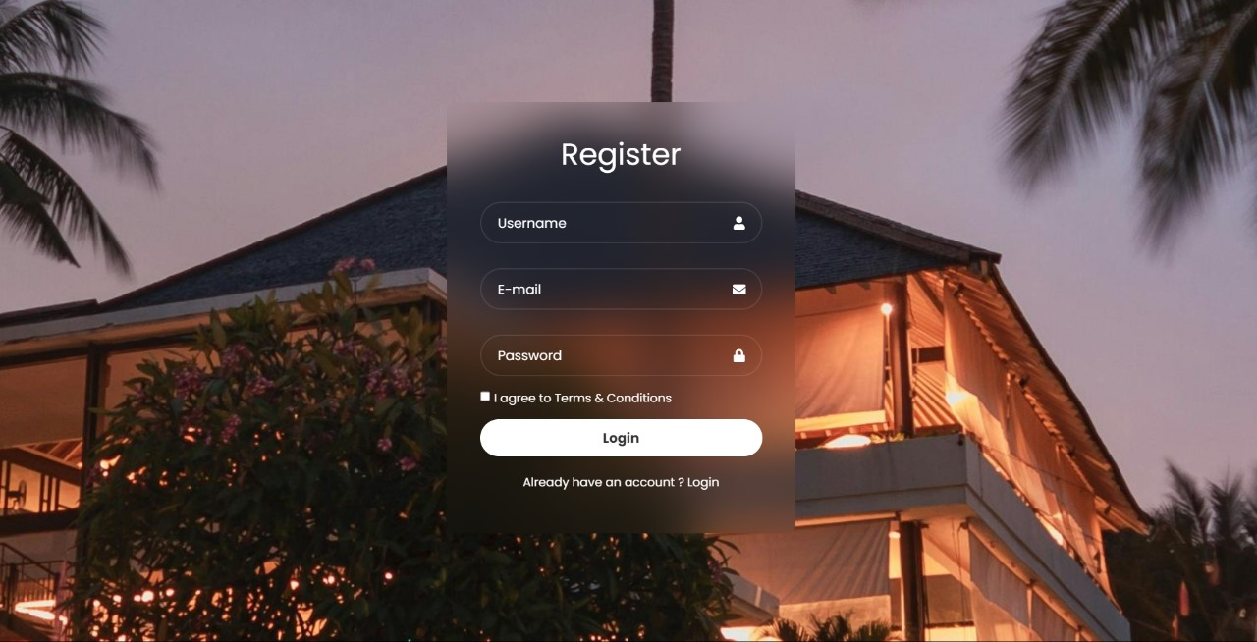
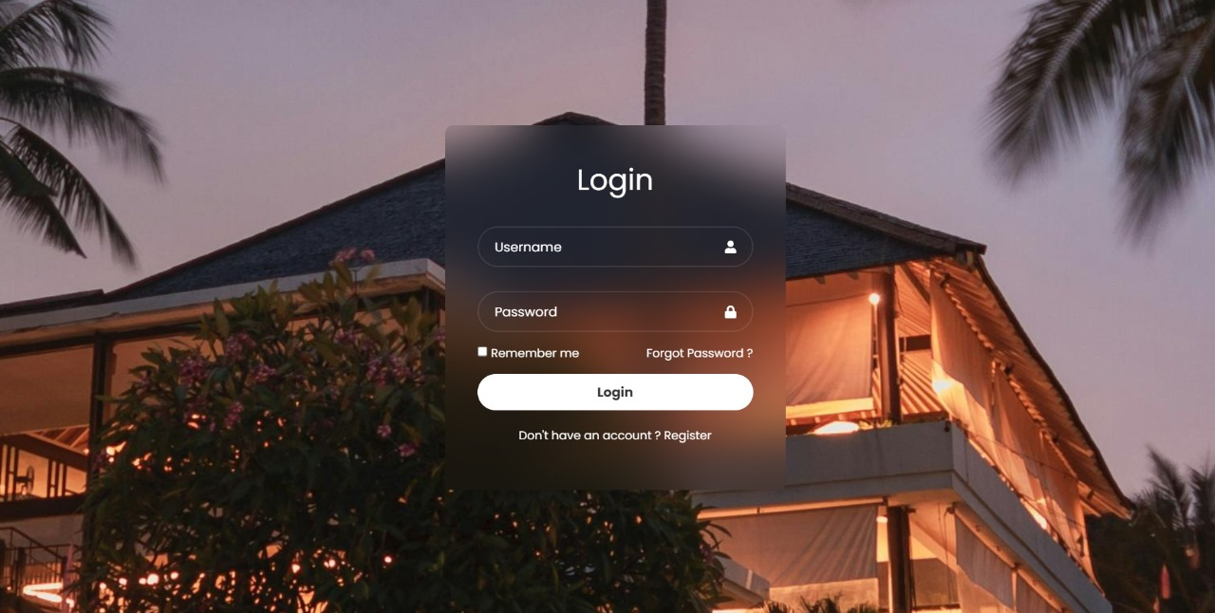

Slide 10
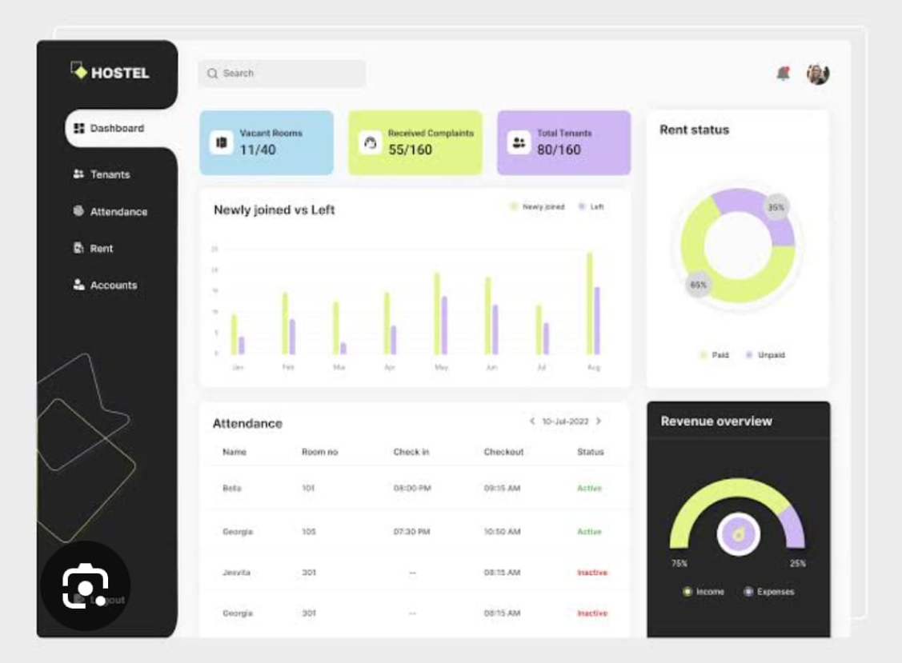

Slide 11
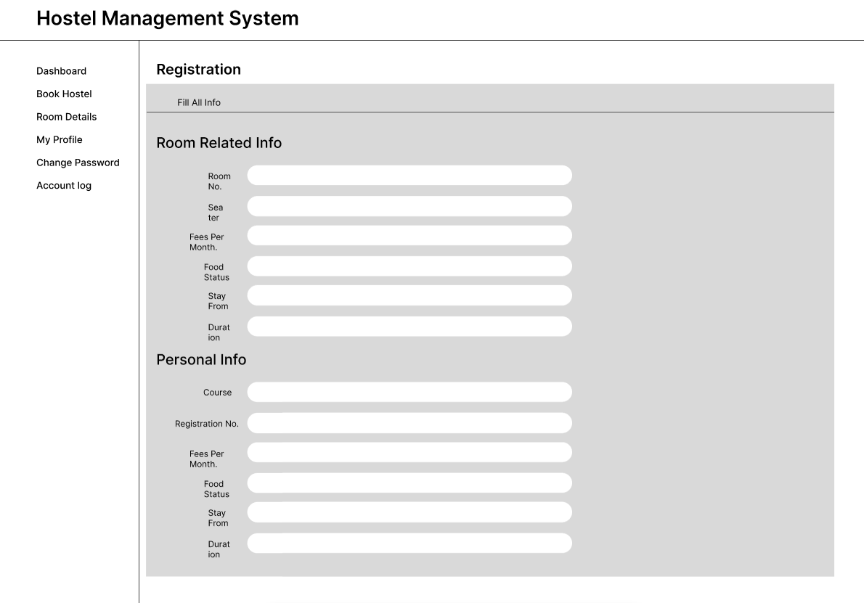
Figma designs for other pages/features

Slide 12
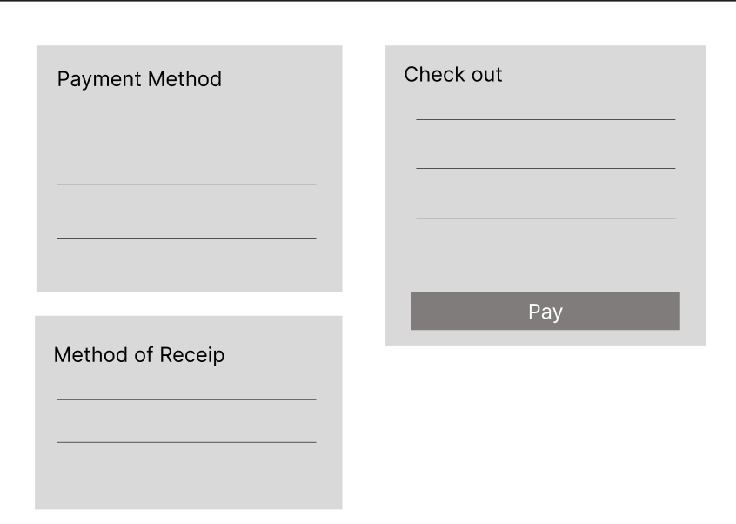

Slide 13
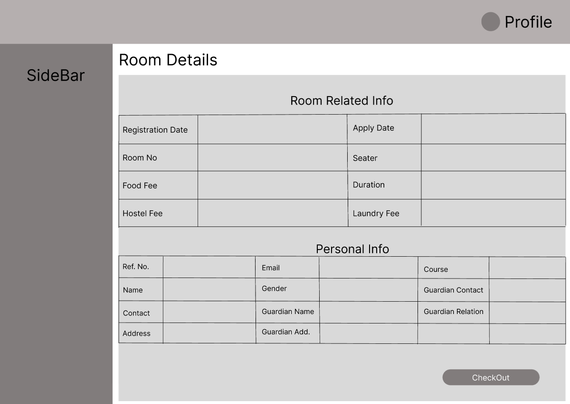

Slide 14
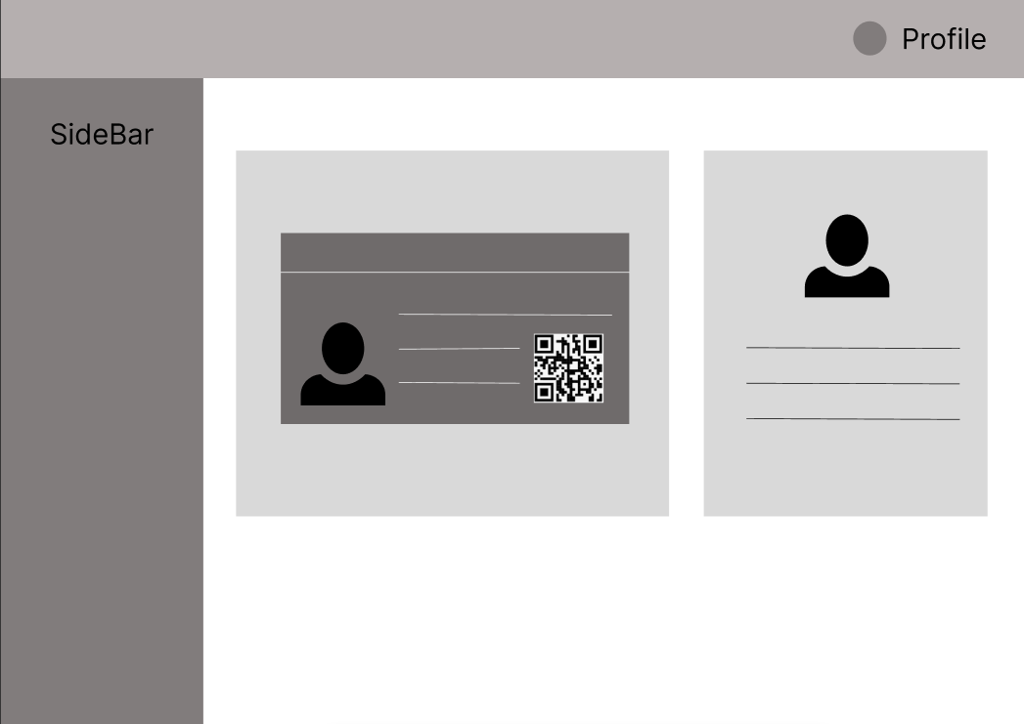
Mess Card

Slide 15
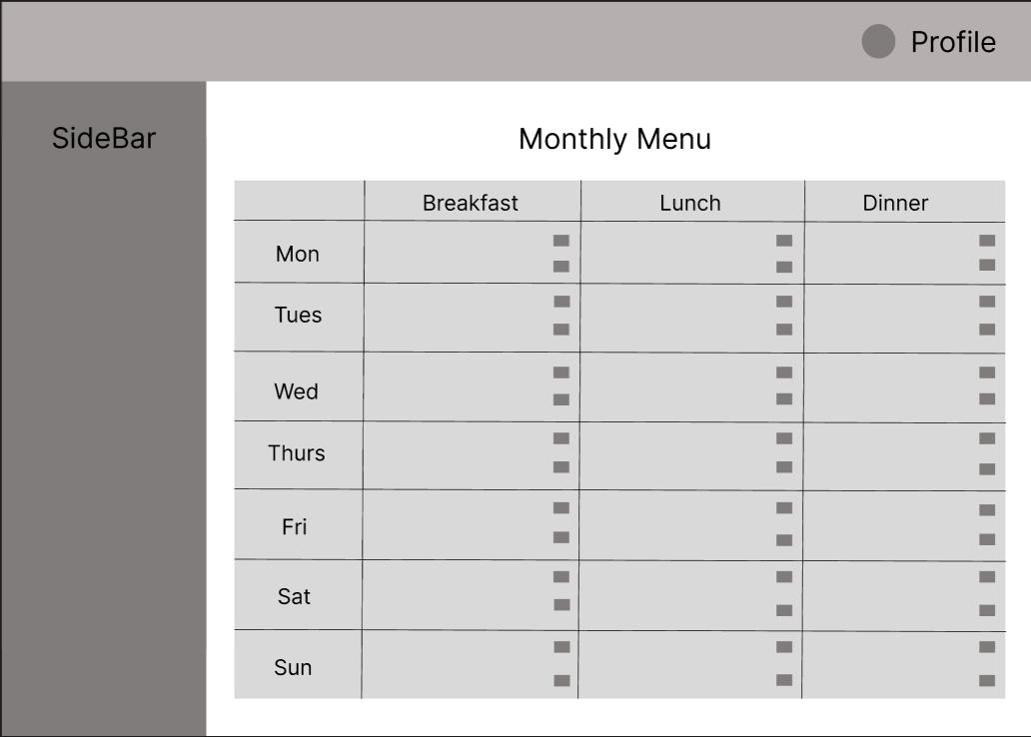

Slide 16
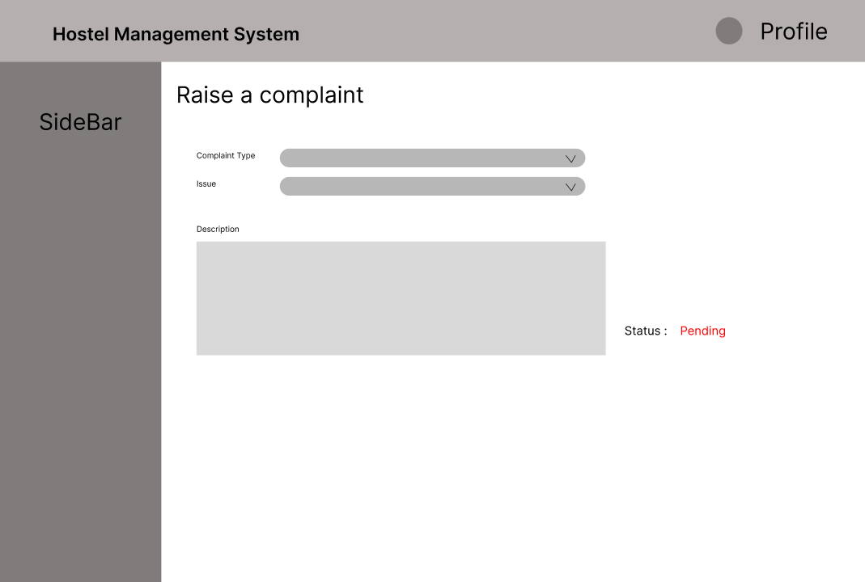

Slide 17
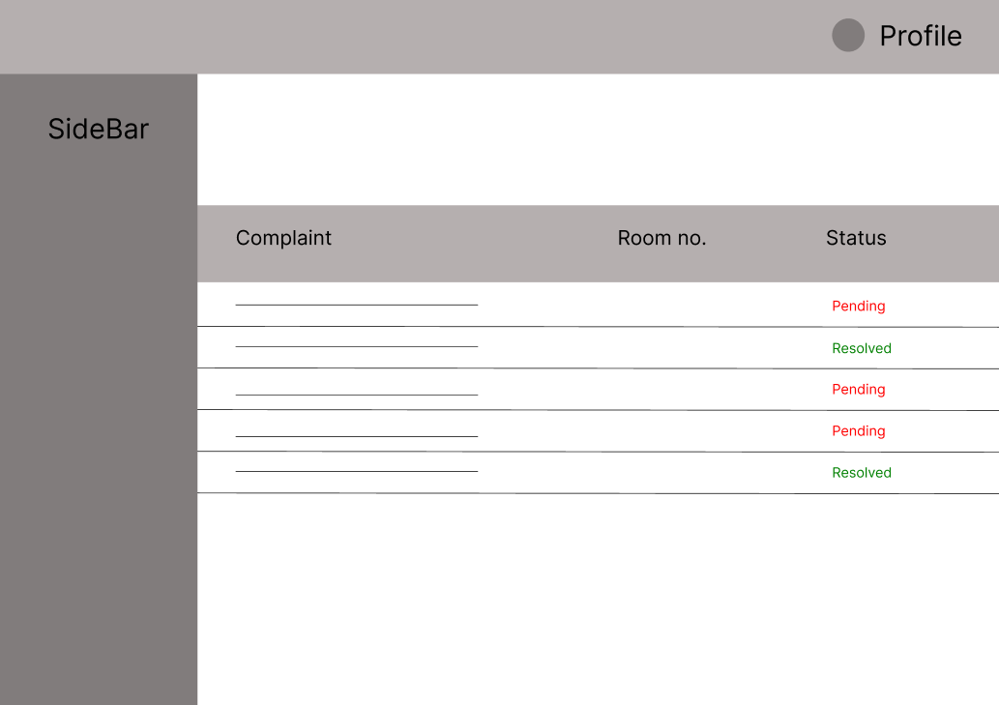

Slide 18
TECHNOLOGIES AND TOOLS
Local Development:
Frontend: React.js for building the user interface. Tools like create-react-app can help you get started quickly.
Backend: Node.js with Express.js for creating RESTful APIs.
Database: Use a database like MySQL, MongoDB for storing data.
Version Control: Use Git for version control, and GitHub for collaboration and repository management.
Platform-as-a-Service (PaaS):
Netlify: It offers easy deployment for static and serverless React apps.

Slide 19
Conclusion
Hostel Sync offers an efficient solution to address the challenges faced by hostels. By automating key processes, enhancing transparency, and improving communication, the system empowers hostel administrators to effectively manage their operations and provide a better overall experience for students and staff.
Efficiency: The Hostel Management System automates routine tasks, reducing manual labor and improving efficiency.
Transparency: The system provides real-time access to information, enhancing transparency and accountability.
Communication: Improved communication channels facilitate better interaction between students, staff, and administrators.
Paperless: The system reduces paperwork, saving time, space, and resources.
User-friendly: The intuitive interface makes the system easy to use for both administrators and students.
Scalability: The system can accommodate hostels of varying sizes and complexities.

Slide 20
Future Scope
The Hostel Management System has significant potential for future development and expansion. Here are some areas to consider:
Integration with other systems: Integrating the system with other campus-wide systems, such as student information systems (SIS), financial systems, and learning management systems (LMS), can streamline processes and provide a more holistic view of student data.
Mobile app: Developing a mobile app for students and staff would allow for convenient access to hostel information and services, such as making payments, submitting maintenance requests, and viewing announcements
Automated notifications: Implementing automated notifications can keep students and staff informed about important events, such as upcoming deadlines, changes in rules, or maintenance schedules.
Customizable dashboards: Providing customizable dashboards for administrators can allow them to tailor the system to their specific needs and preferences.
SaaS Model: Providing the services through SaaS model to incorporate other institutions, universities at a premium.

Slide 21
Bibliography/References
Websites and Online Resources:
React.js Official Documentation (reactjs.org) – For understanding React.js concepts, components, and hooks.
NPM Documentation– For accessing various npm libraries.
Articles and Tutorials:
"Understanding REST APIs" on Medium – For insights into building and consuming RESTful APIs.
"Building a Simple Node.js Backend" on Dev.to – A step-by-step guide for setting up a basic backend with Node.js and Express.
Tools and Libraries Documentation:
Node.js Documentation (nodejs.org) – For understanding the Node.js runtime and its capabilities.

Slide 22
Thank You
22

